Slide 1
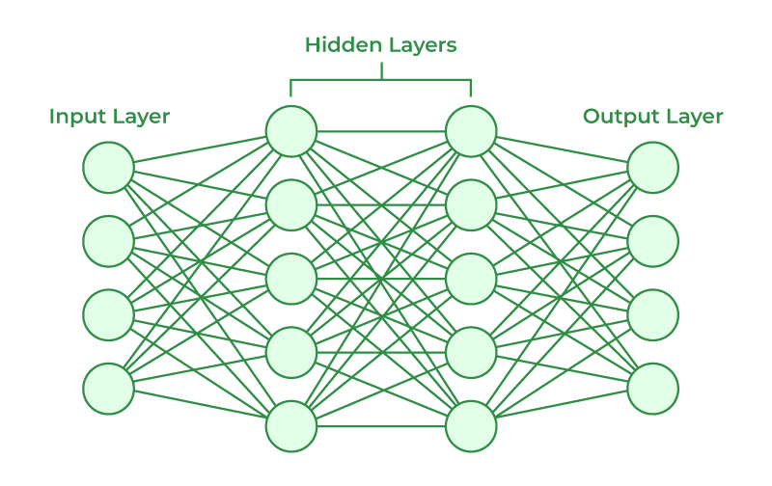
Emotion Detection In Text
Neural Networks Project

Slide 2
Project Idea
The project idea is to develop a model for emotion detection from text using neural networks. It uses TensorFlow and Keras libraries for building and training the neural network model. The project aims to classify texts and understand the associated emotions, such as happiness, sadness, anger, fear, and disgust.

Slide 3
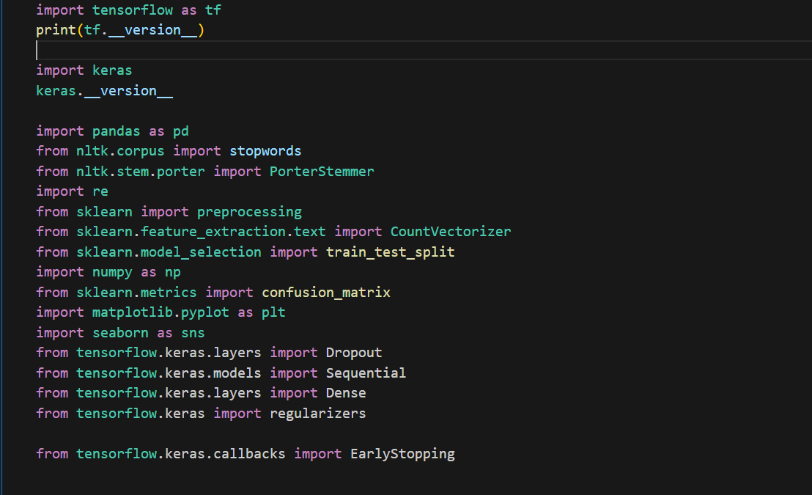
The project is implemented through the following steps:
1- Importing necessary libraries: TensorFlow, Keras, pandas, NLTK, re, sklearn, numpy, matplotlib, seaborn.

Slide 4
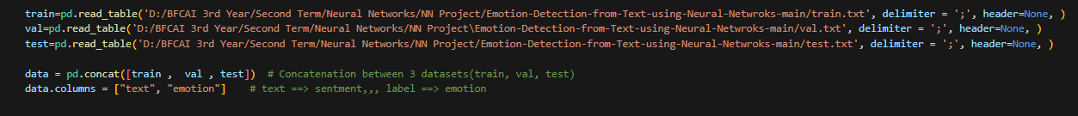
The project is implemented through the following steps:
2- Reading the dataset: The code reads three text files - train.txt, val.txt, and test.txt - which contain the training, validation, and test data respectively.

Slide 5
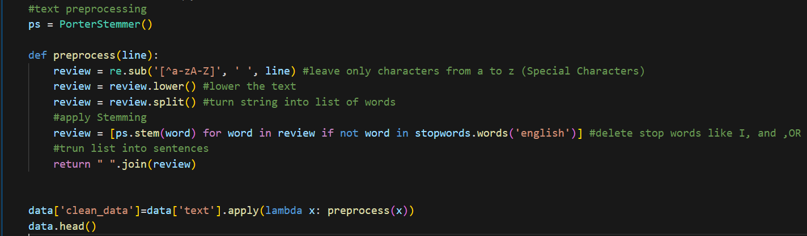
The project is implemented through the following steps:
3- Preprocessing the data: The text data is preprocessed by removing special characters, converting text to lowercase, splitting into words, applying stemming, and removing stop words.

Slide 6
The project is implemented through the following steps:
4- Encoding labels: The emotion labels are encoded using label encoding to convert them into numerical values.

Slide 7
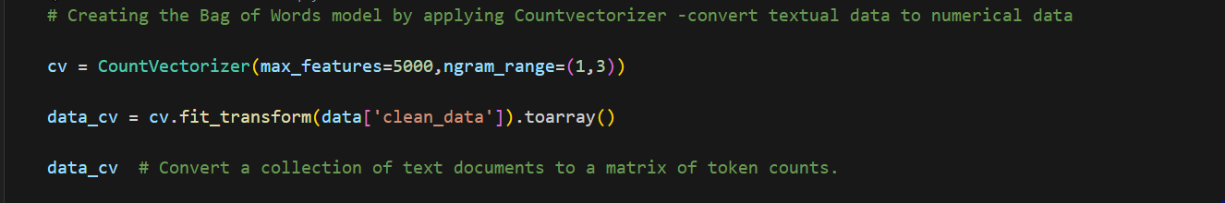
The project is implemented through the following steps:
5- Creating the Bag of Words model: The text data is converted into a matrix of token counts using the CountVectorizer from sklearn.

Slide 8
The project is implemented through the following steps:
6- Splitting the data: The data is split into training and testing sets.

Slide 9
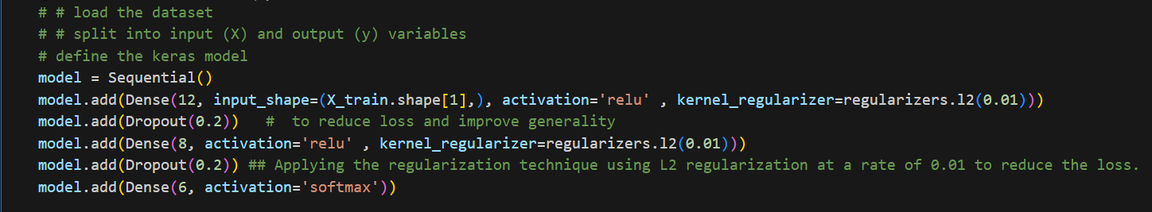
The project is implemented through the following steps:
7- Building the neural network model: The code defines a sequential model using Keras and adds dense layers with dropout regularization.

Slide 10
The project is implemented through the following steps:
8- Compiling the model: The model is compiled with the loss function, optimizer, and metrics.

Slide 11
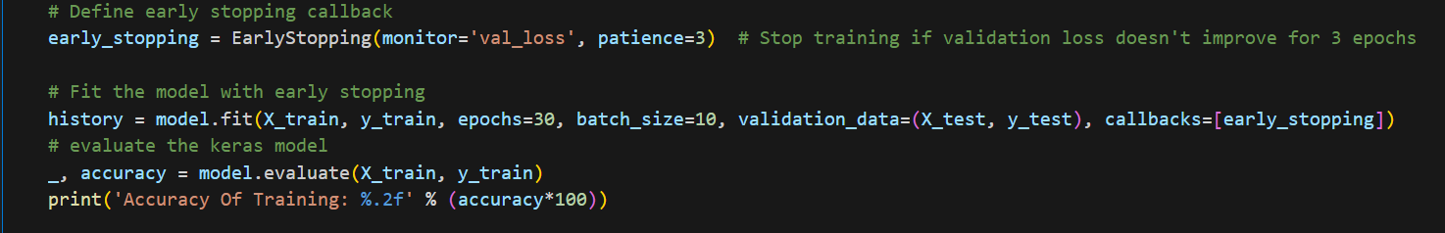
The project is implemented through the following steps:
9- Training the model: The model is trained on the training data with early stopping applied to prevent overfitting.

Slide 12
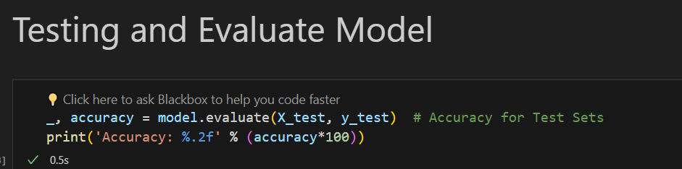
The project is implemented through the following steps:
10- Evaluating the model: The model is evaluated on the training and testing data, and the accuracy is calculated.

Slide 13
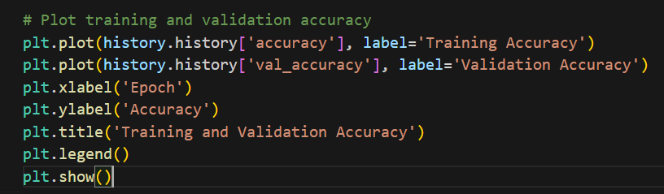
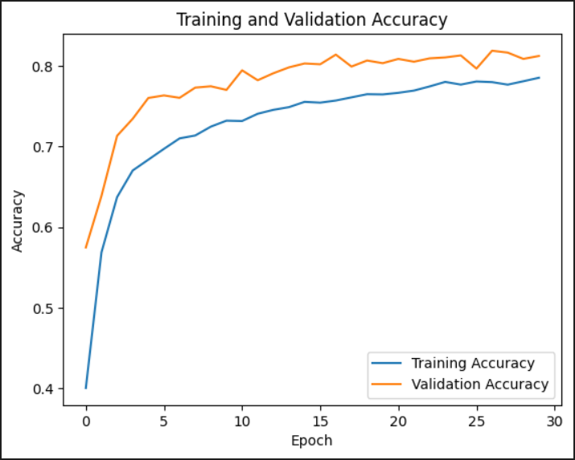
The project is implemented through the following steps:
11- Visualizing the training and validation accuracy: The training and validation accuracy for each epoch are plotted.

Slide 14
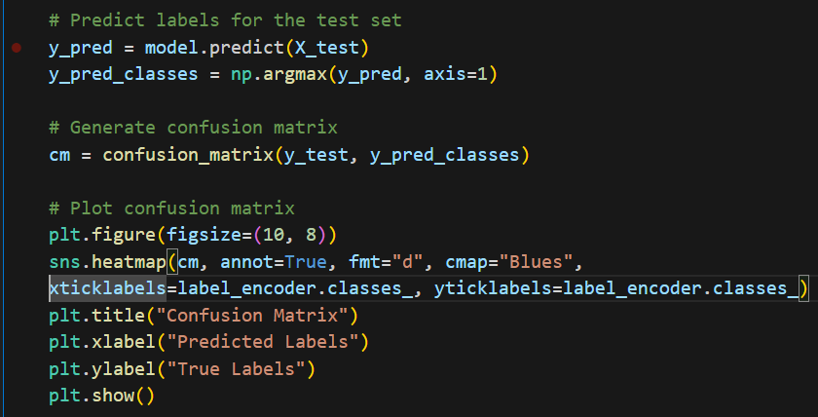
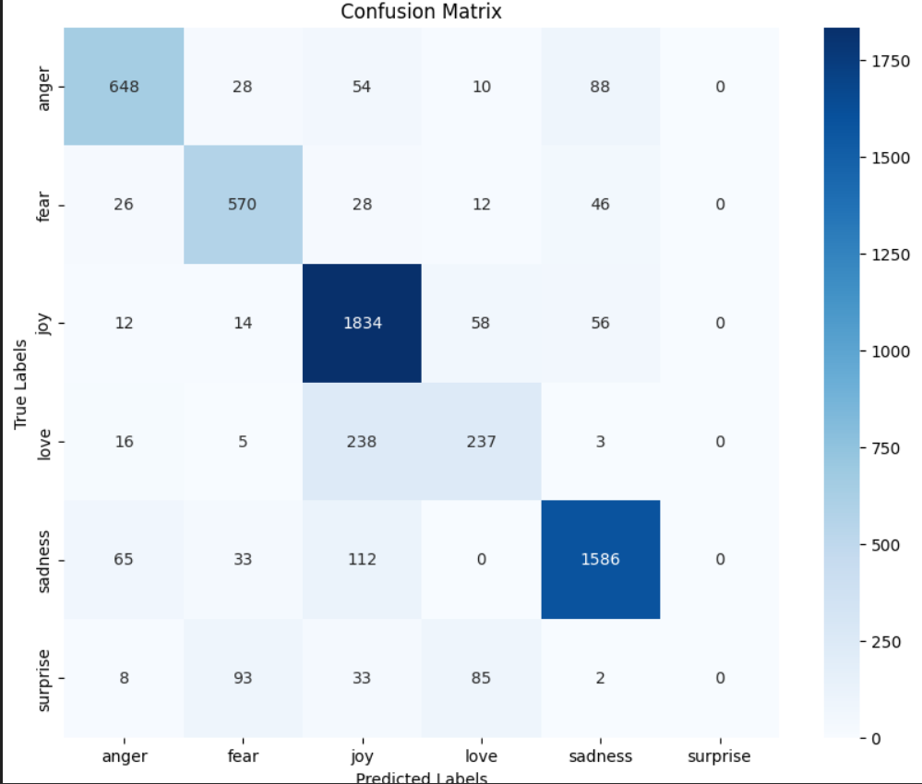
The project is implemented through the following steps:
12- Confusion matrix: The confusion matrix is generated to evaluate the performance of the model.

Slide 15
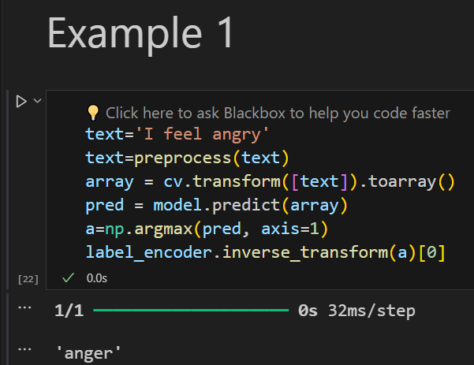
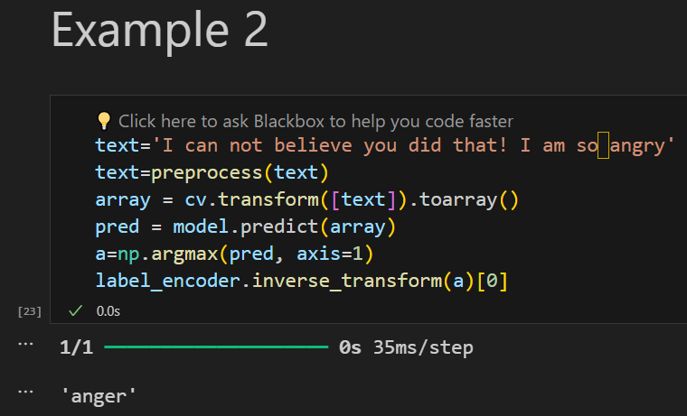
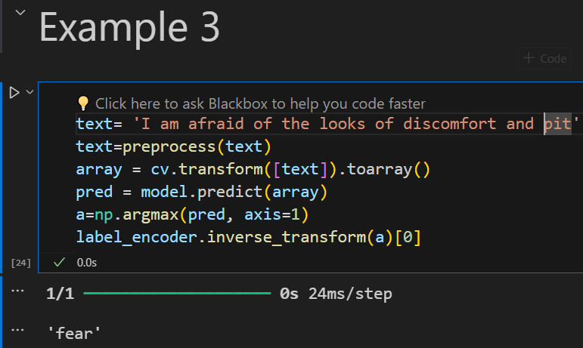
The project is implemented through the following steps:
13- Examples for testing the model: Several examples are provided to test the model's prediction for different input texts.

Slide 16
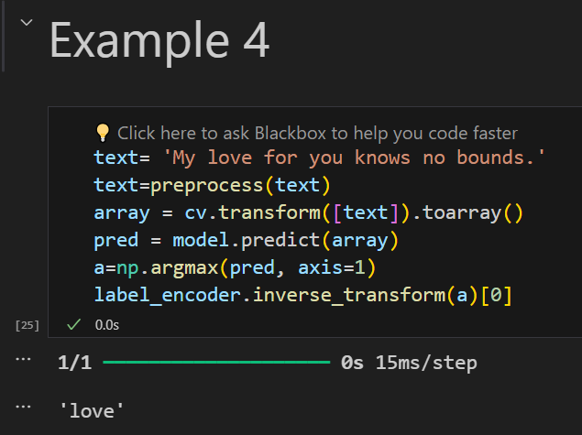
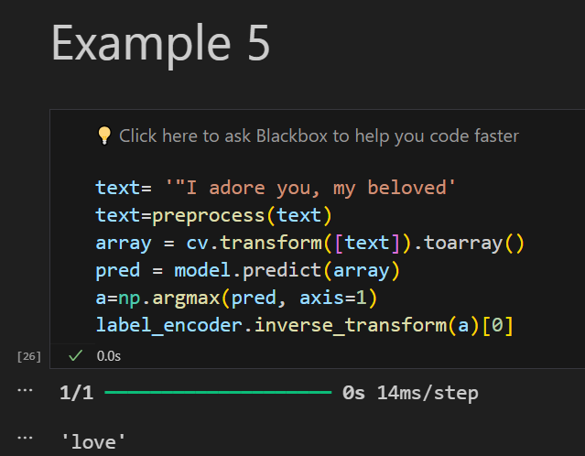
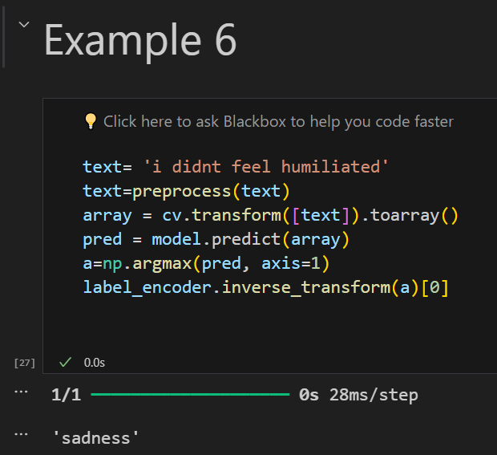
The project is implemented through the following steps:
13- Examples for testing the model: Several examples are provided to test the model's prediction for different input texts.

Slide 17
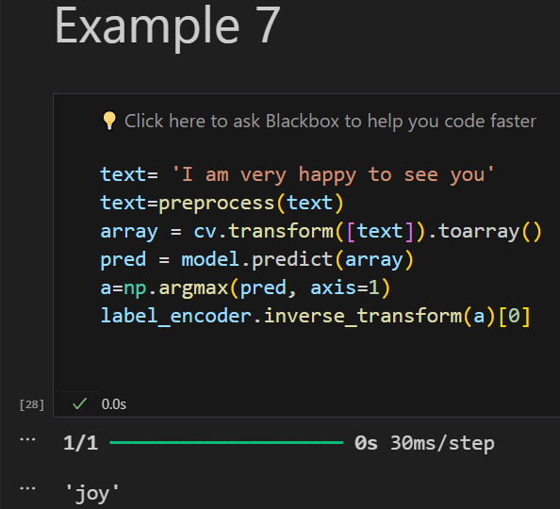
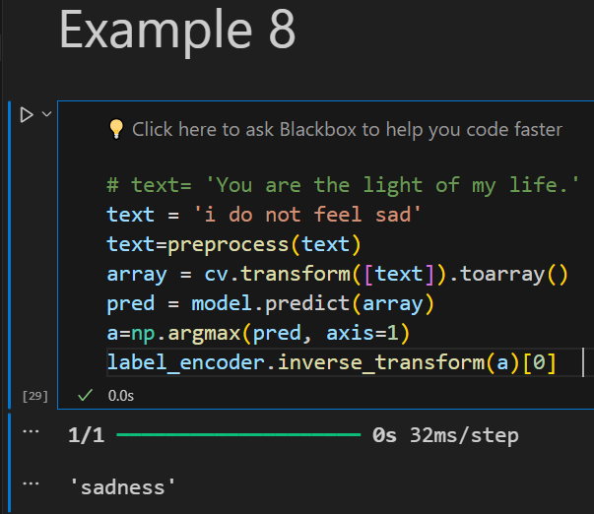
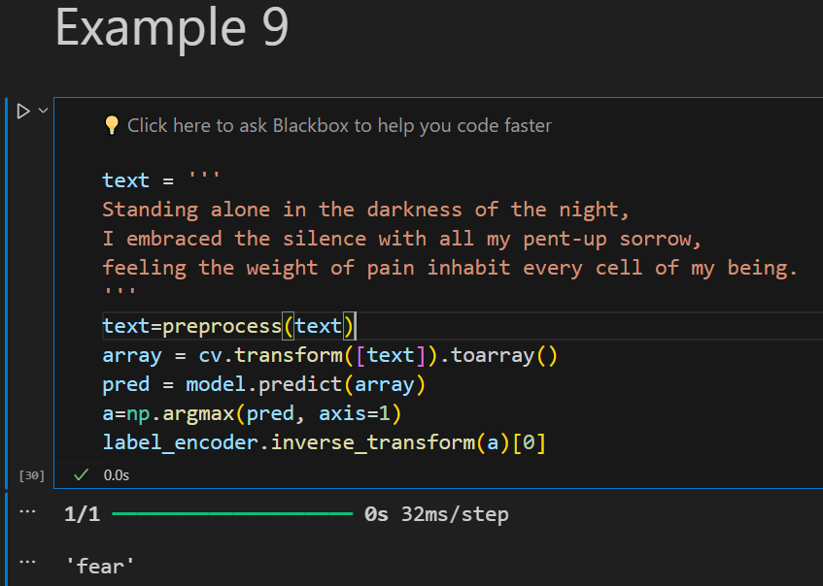
The project is implemented through the following steps:
13- Examples for testing the model: Several examples are provided to test the model's prediction for different input texts.

Slide 18
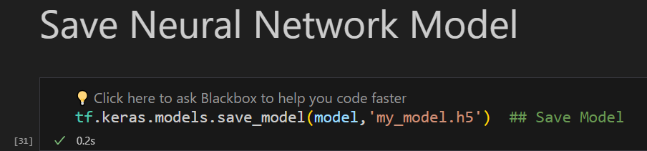
The project is implemented through the following steps:
14- Saving the model: The trained neural network model is saved as "my_model.h5".

